Slide 1
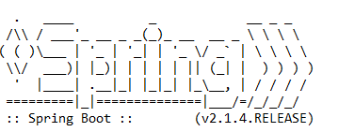
How to disable spring logo banner in spring boot?
By default, all spring boot applications will show up below spring logo banner in all spring boot applications.
$ java -Dspring.main.banner-mode=off -jar myAppBundle.jar

